Slide 1
1948 Election and Cold War

Slide 2
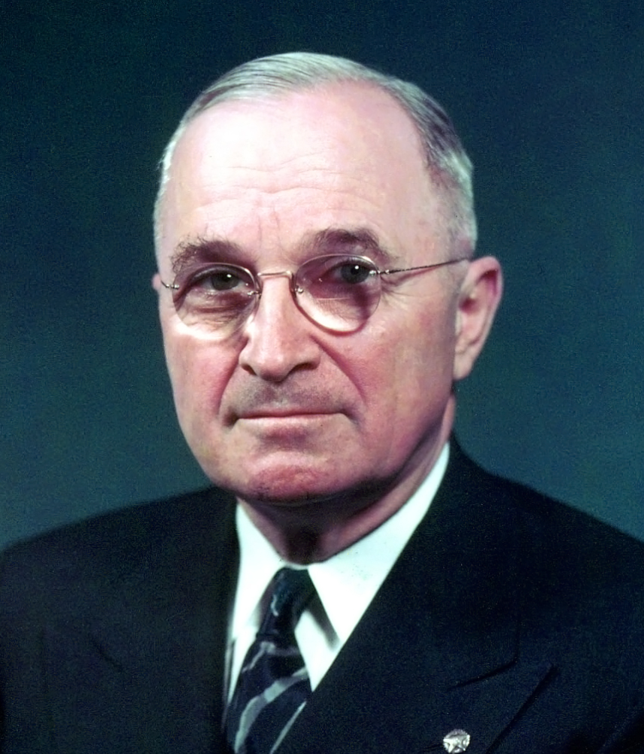
1948 election
From Missouri Grandparents slave owners
Harry Truman 1882-1972
Kansas City ‘machine” politics
elections..competitive thuggery
No personal enrichment
…father in- law foreclosure
Voracious reader/ good pianist
No International background …and yet ..decision to use bomb..Marshall Plan/ Berlin Airlift
New Deal reformer…use
government to help the people

Slide 3
Truman quotes
My choice early in life was either to be a piano player in a whorehouse or a politician. To tell the truth, there's hardly a difference.
I can remember when a good politician had to be 75 percent ability and 25 percent actor, but I can well see the day when the reverse could be true.
A pessimist is one who makes difficulties of his opportunities and an optimist is one who makes opportunities of his difficulties
We must face the fact that peace must be built on power, as well as upon good will and good deeds.

Slide 4
Truman and race
As 27 year old farmer ““I think one man is just as good as another so long as he’s honest and decent and not a nigger or a Chinaman… I am strongly of the opinion that negros (sic) ought to be in Africa, yellow men in Asia and white men in Europe and America.”
Remains white supremacist/ uses racist words but views change
At 65…as President after lynching of black GI’s in uniform ““My stomach turned over when I learned that Negro soldiers, just back from overseas, were being dumped out of army trucks in Mississippi and beaten,” Truman said. “Whatever my inclinations as a native of Missouri might have been, as president I know this is bad. I shall fight to end evils like this.”

Slide 5
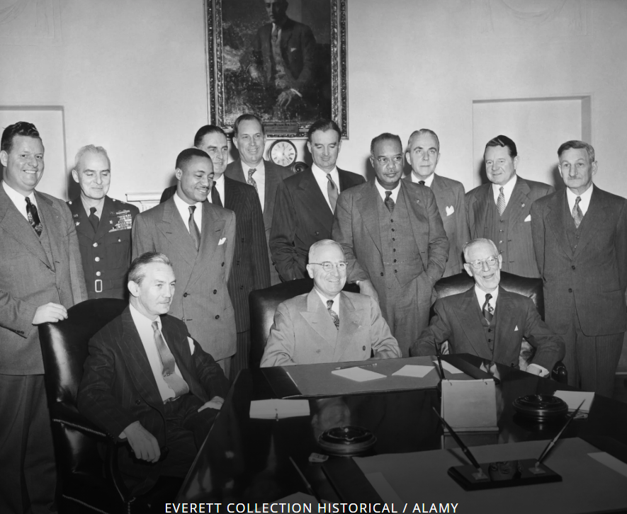
Executive Order 9981..ending discrimination in military ..1948….army resists…not in effect till 1954

Slide 6
Election campaign
Truman seeks second (full) term
offers “Fair Deal”: the politics of abundance
Compulsory national health insurance plan/ guaranteed jobs scheme
Seeks minority support: Northern blacks…Civil Rights/ Jews ..new state of Israel
Fear of communism drives election
Truman introduces Loyalty Oath….all Federal employees…3,000 out of 1 million terminated
Sets up Central Intelligence:
Democratic Party splits over civil rights and anti communism
Dixiecrats (White Supremacists0 ….replace Democrats in South: no ”Solid South” Progressive Party …splits northern vote..liberal

Slide 7
Truman appears doomed
Republicans pick Thomas Dewey
…..Progressive Conservative
…..Election result obvious…say nothing but platitudes
…….”You know your future is still ahead of you” !
Republican feed off strikes of 1946: pass anti union “Taft Hartley” law
Bans closed shops
Allows Right to Work (i.e. no union) States
Truman vetoes bill but Senate overrides
Truman…”the man who lost China”, Marshal/ FDR Russian “dupe , pro union

Slide 8
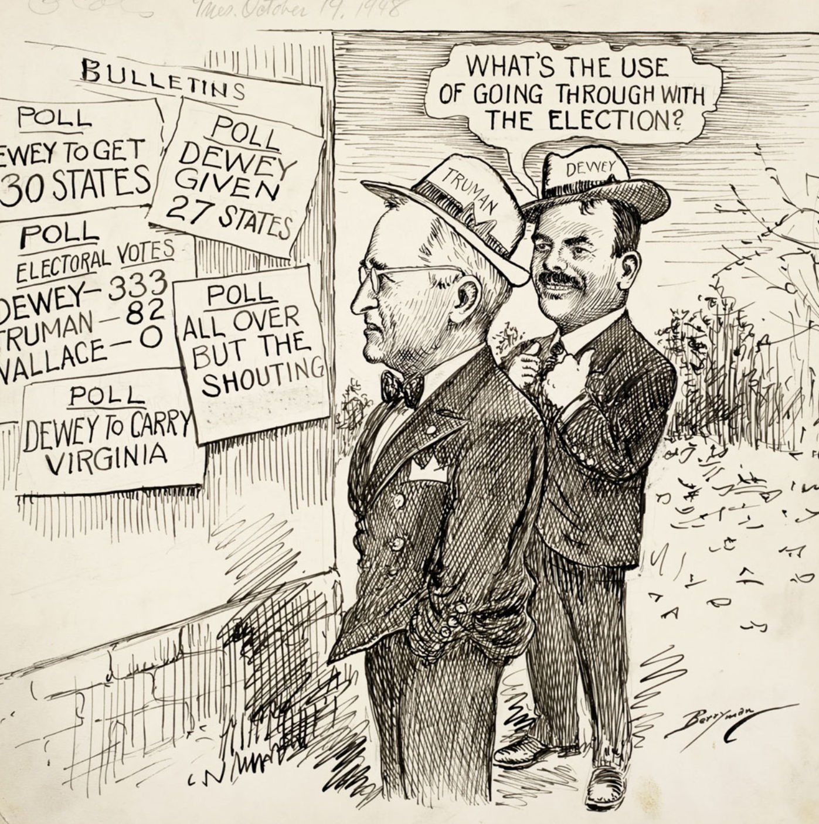
The campaign: a forgone conclusion

Slide 9
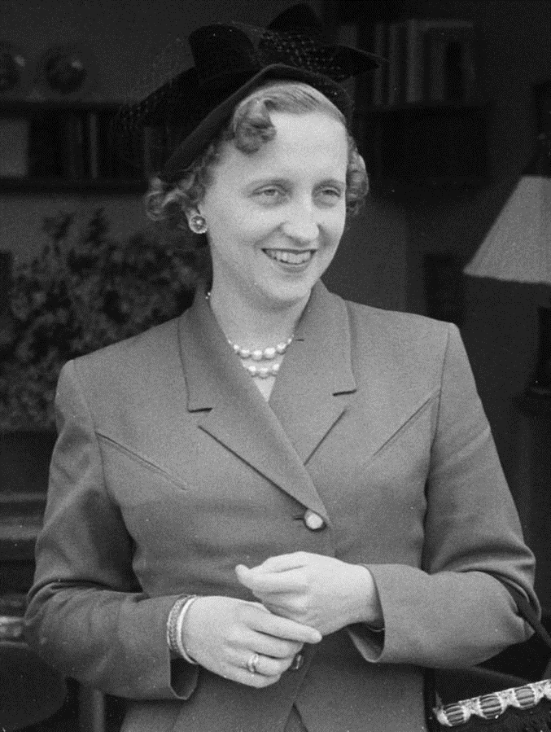
Truman “road show”: Bess and Margaret
Truman a family man: “Three things ruin a
man: power, money, and women. I never
wanted power. I never had any money,
and the only woman in my life is up at the house right now.” .. married 55 years!
Margaret Truman 1924-2008)
Margaret only daughter
…opera singer career
…Truman promotes to major opera houses
…considered good, not great
Truman 1948 aggressive campaign:
…Speech by Harry “Give em Hell Harry”
…song by Margaret/ …duet Harry & Margaret
…then “meet the Boss”..Bess
Margaret marries….successful writer of
Murder mysteries (“murder in Havana”
“murder at CIA…murder at Pentagon,
Murder at Congress”

Slide 10
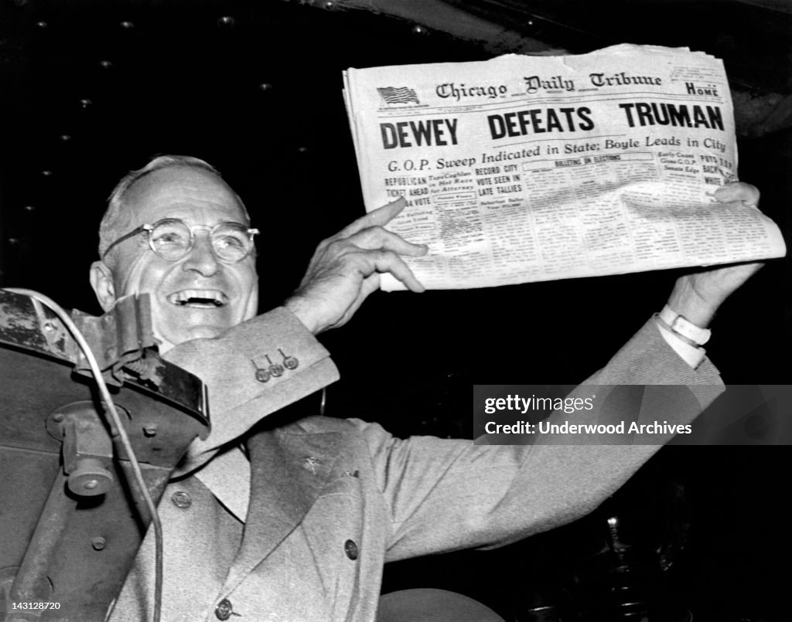
The joys of beating the polls

Slide 11
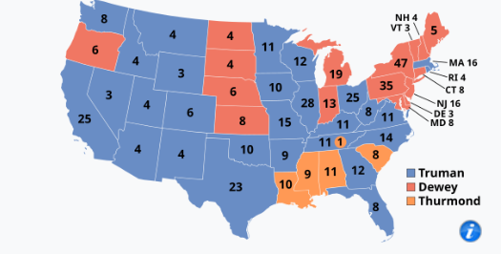
Result….biggest surprise till Trump
Truman wins college
Dem 303, Rep 189, Dixicrats 39
Wins popular vote by 2m
…49% vote vs 45%
Democrats lose “Solid South”
First time since civl war
….due to civil rights initiatives
Dems lose NY…8% vote to Progressives
Win Detroit (Michigan)
Chicago, Illinois

Slide 12
Election aftermath
Democrats regain control of house, Republicans the Senate
“Fair Deal” dies in committee
Cold war intensifies
US/UK agree to create “West Germany”
Japan and West Germany to be reindustrialised
Nato established April 1949 military alliance
“Unamerican Activites” Committee in Senate steps up pressure…spy network
Then on August 29th 1949 something completely unexpected

Slide 13
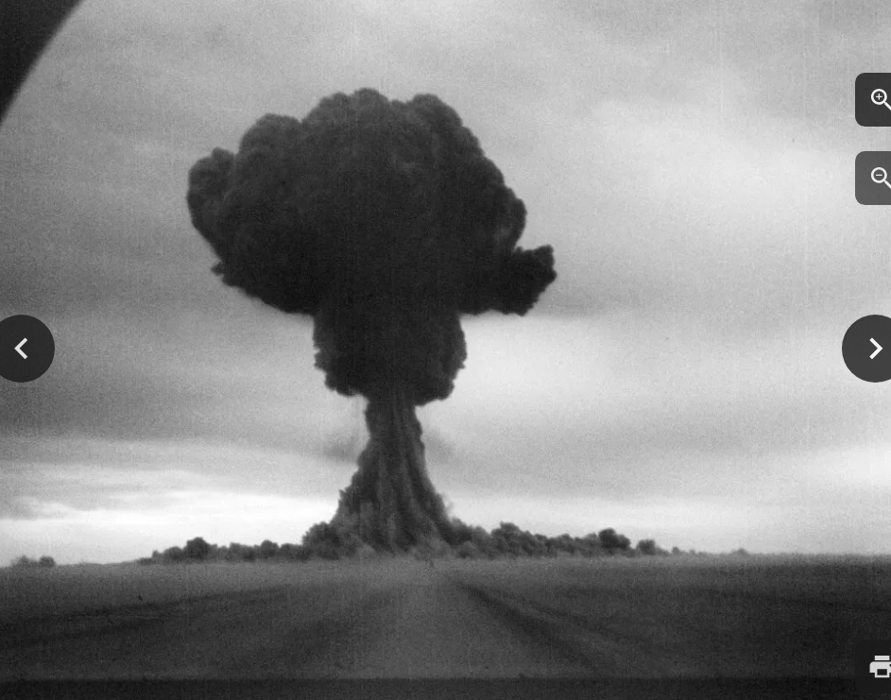
Russian Atomic bomb

Slide 14
Next talk34: USA during the 1950’s.. March 17th
Then Talk 35: The cold war during the 1950’s

